Slide 1
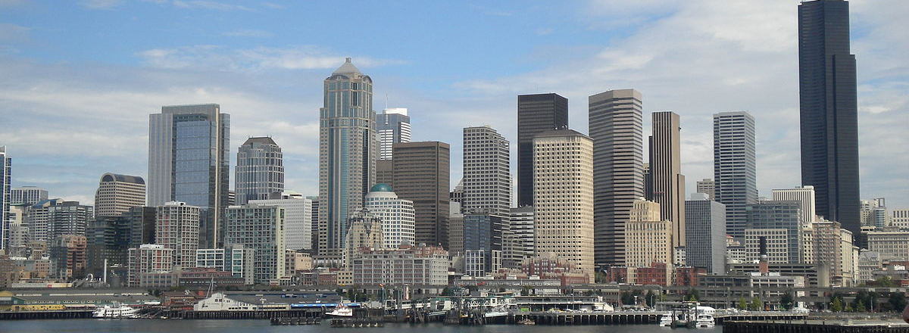
SEATTLE Accidents Prediction project

Slide 2
Project Background
The Seattle Traffic Division (*) aims to reduce and if possible, predict the number of accidents
As of May 2020 the number of accidents with personal injuries and property damages are:
Note: (*) referred as SDT in the future

Slide 3
Project Objectives
Develop a Machine Learning model able to predict an accident and its type based on a set of selected variables
Provide recommendations to the Seattle Traffic Division to reduce the number of accidents

Slide 4
Project Phases
Data Cleansing
Exploratory analysis
Prepare dataset for machine learning models
Simulation
Results
Conclusions
Recommendations to the Seattle Traffic Division

Slide 5
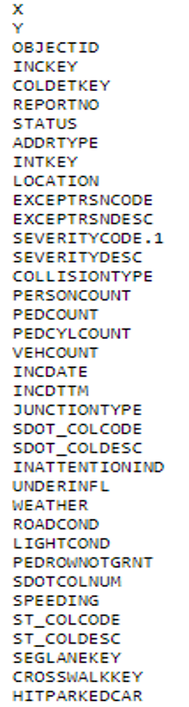
Data at a Glance
Number of records: 194,673
URL
Time frame: 2004 to 2020
Dependent variable:
Accident Severity:
Injury
Property damage
Independent variables:

Slide 6
Data CLEANSING
Eliminate all non friendly Machine Learning records affecting the project variables of interest:
Predicted and dependent variable:
SEVERITYCODE
Independent variables:
ADDRTYPE, JUNCTIONTYPE, X, Y, PERSONCOUNT, PEDCOUNT, PEDCYLCOUNT, VEHCOUNT, ROADCOND, : WEATHER, LIGHTCOND
As result of the data cleaning 164,731 records remained

Slide 7
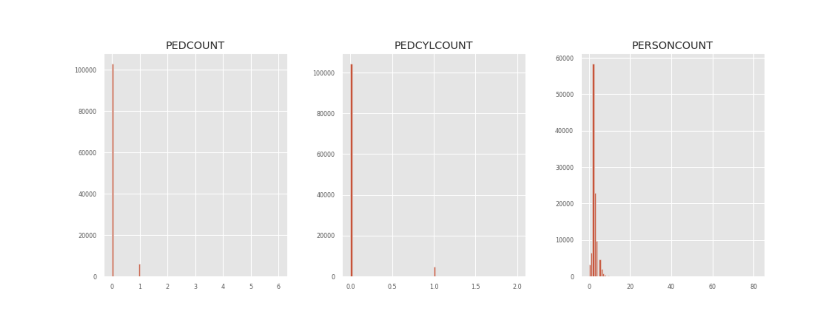
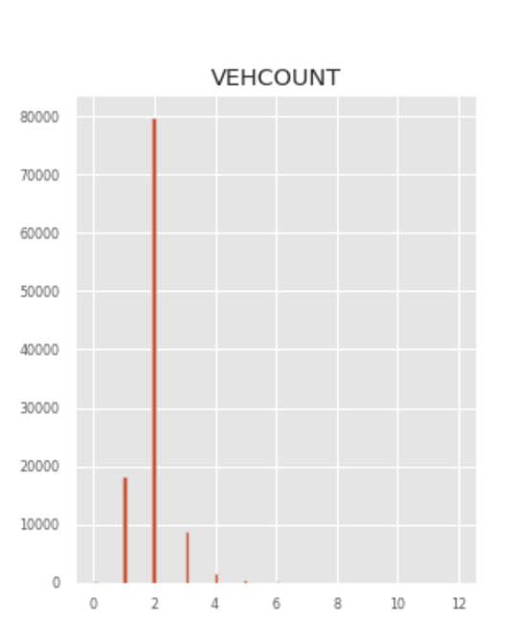
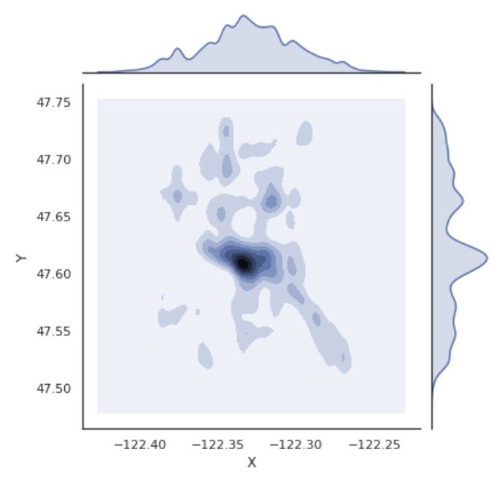
Exploratory analysis Numerical variables
Histograms: Number of pedestrians, cyclist, people and vehicles per accident
Density map: Accidents location
Analysis outcome
Low variability: most samples concentrate around very few different values
Will not provide too much new information in order to predict an accident as they will act more as a constant factor
Low correlation (below 0.5) among them and towards the dependent variable

Slide 8
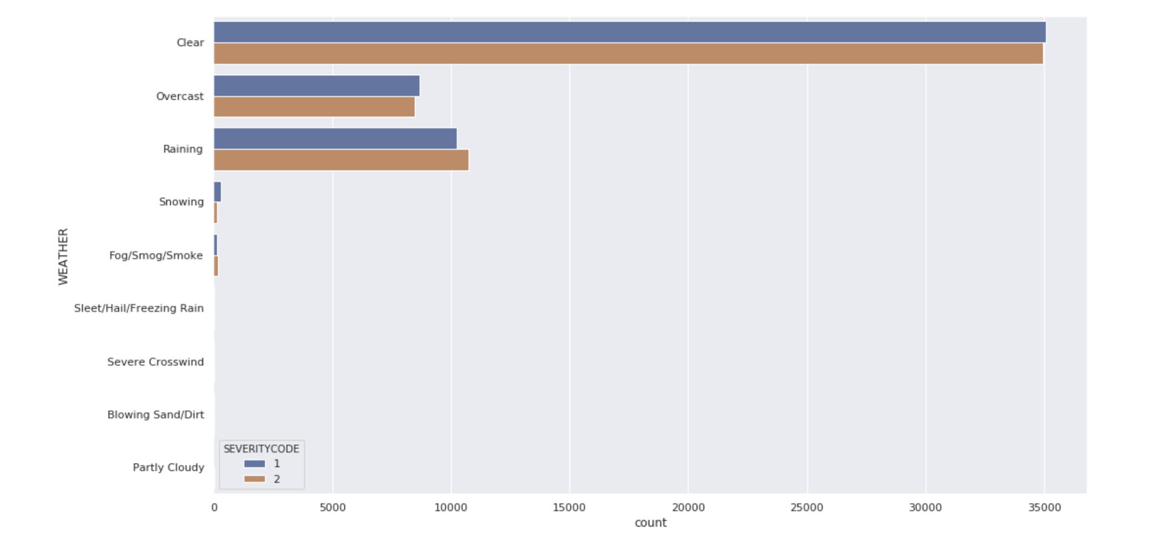
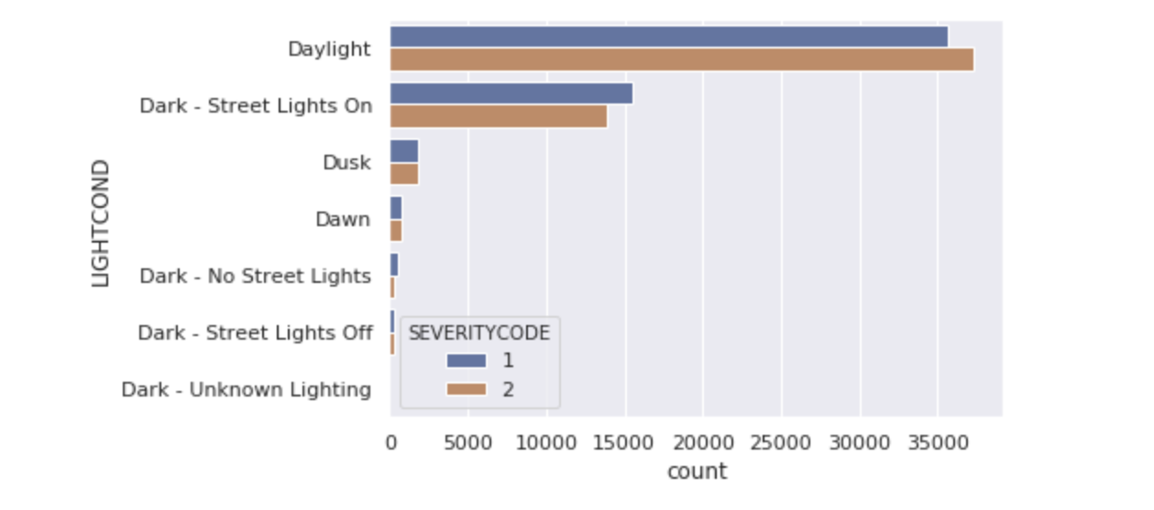
Exploratory analysis– Categorical variables
Weather
Lighting conditions

Slide 9
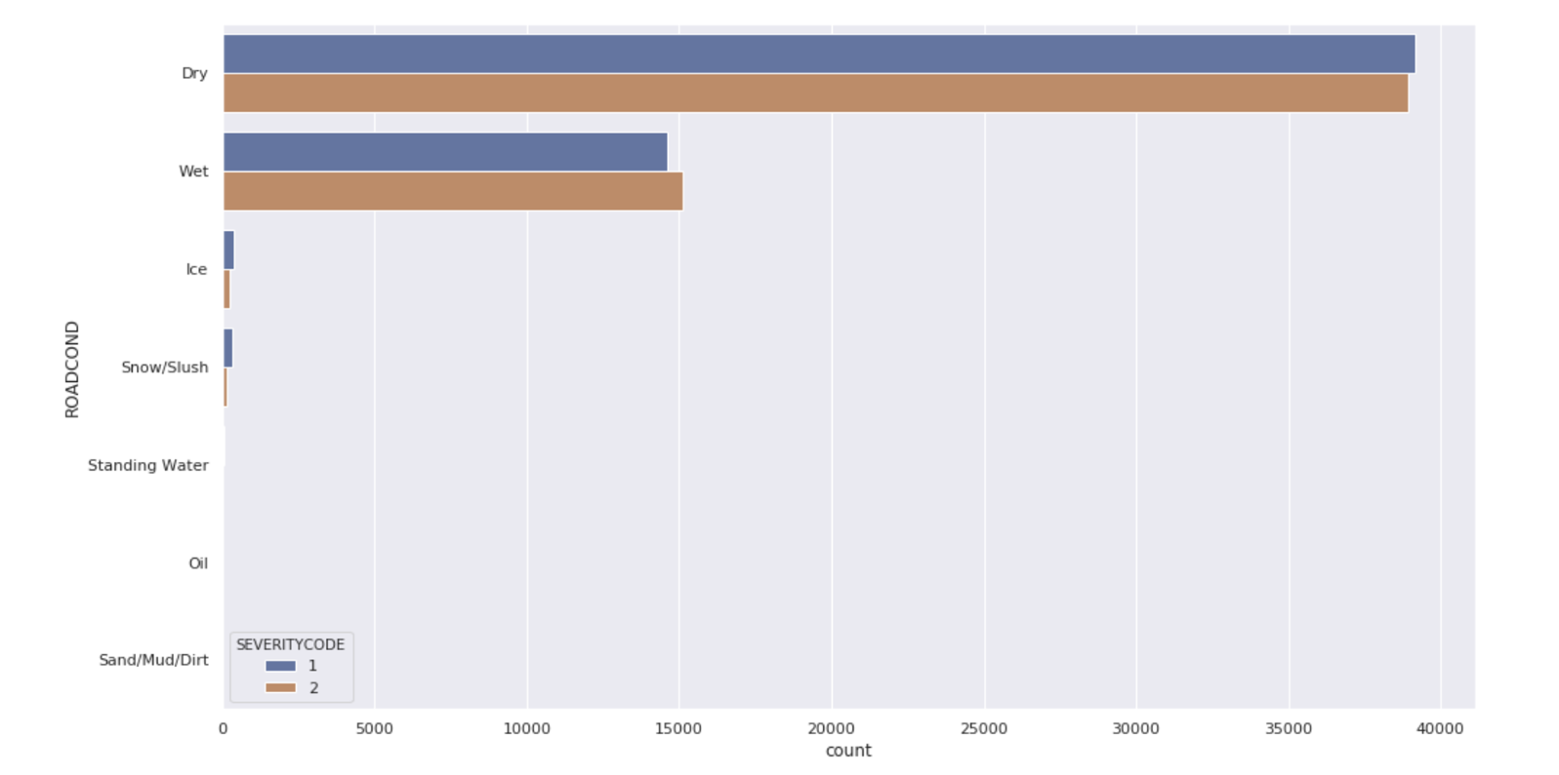
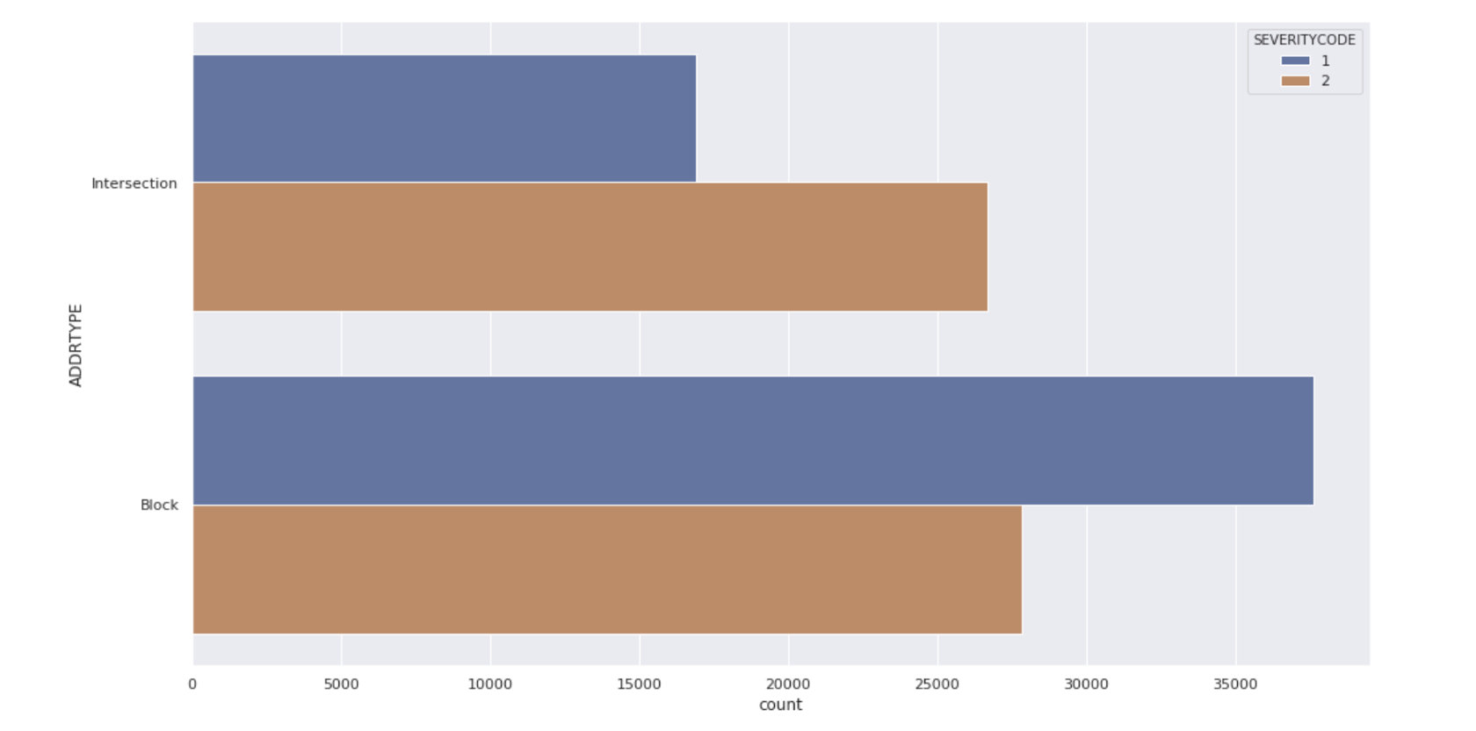
Exploratory analysis– Categorical variables
Type of Address
Road condition

Slide 10
Exploratory analysis– Categorical variables
Outcome
The majority of the accidents are related to good weather and infrastructure conditions
The intersections are locations with more accidents with personal injuries while in the blocks , the property damage are higher.

Slide 11
Prepare data for Machine learning algorithms
Select variables for training and test the models:
Address Type, Light conditions, Weather, Road Condition
Encode these categorical variables to numerical values
Number of cases per accident type :
Down sampling method applied, as consequence number of records for both 54, 544
Accident type | Number of cases
Property damage | 110187
Injury | 54544

Slide 12
Simulation- models
Model | Classification method
K nearest neighbours | Similarity measure. How its neighbors are classified
Decision tree | Via a tree structure where leaves and nodes contains specific features of the training samples.
Support Vector Machine | Hyperplane in a N dimensional space where N are the features defining the data point in a unique way
Logistic regression | Predictions interpreted as class probabilities

Slide 13
Simulation training- test and Models Parameters
Cross Validation: Training 70% - Test 30% samples
Model | Parameters
K nearest neighbours | Data scaled. K = 50 ( best accuracy)
Decision tree | Entropy criteria Entropy = 6 ( tree deep)
Support Vector Machine | kernel='rbf'
Logistic regression | C – 0.01 Libineal Algorithm

Slide 14
Results
Algorithm | Avg F1 – score | Accident type | Precision | Recall
K nearest neighbours | 0.59 | Property damage | 0.69 | 0.57
 |  | Injury | 0.49 | 0.62
Decision Tree | 0.59 | Property damage | 0.69 | 0.57
 |  | Injury | 0.49 | 0.62
Support Vector Machine | 0.59 | Property damage | 0.57 | 0.69
 |  | Injury | 0.62 | 0.49
Logistic Regression | 0.59 | Property damage | 0.57 | 0.69
 |  | Injury | 0.62 | 0.49
Same accuracy for the all models
K nearest neighbors and Decision Tree has same precision and recall values
Support Vector Machine and Logistic Regression have the same precision and recall values

Slide 15
CONCLUSIONS
The 4 models present a very similar accuracy, around 60%, not exceptional
Within the minor differences among the models, Decision Tree present the highest precision weighted average together with the Knn.
K nn model presents the highest accuracy as of 50 value. In the long run, this will require high computational performance. So Decision Tree seems to be the best option.
The majority of the accidents occur in locations in dry roads , with good visibility, weather conditions

Slide 16
Recommendations
Data collection
The Seattle Traffic Division dataset quality was not high, a lot of records, around 30.000 contained ambiguous or empty values in some of the variables
Recommendation:
Develop an App so the people involved in an accident or responsible authority gather on site the information into an electronic form with some mandatory variables, and without ambiguous options available.

Slide 17
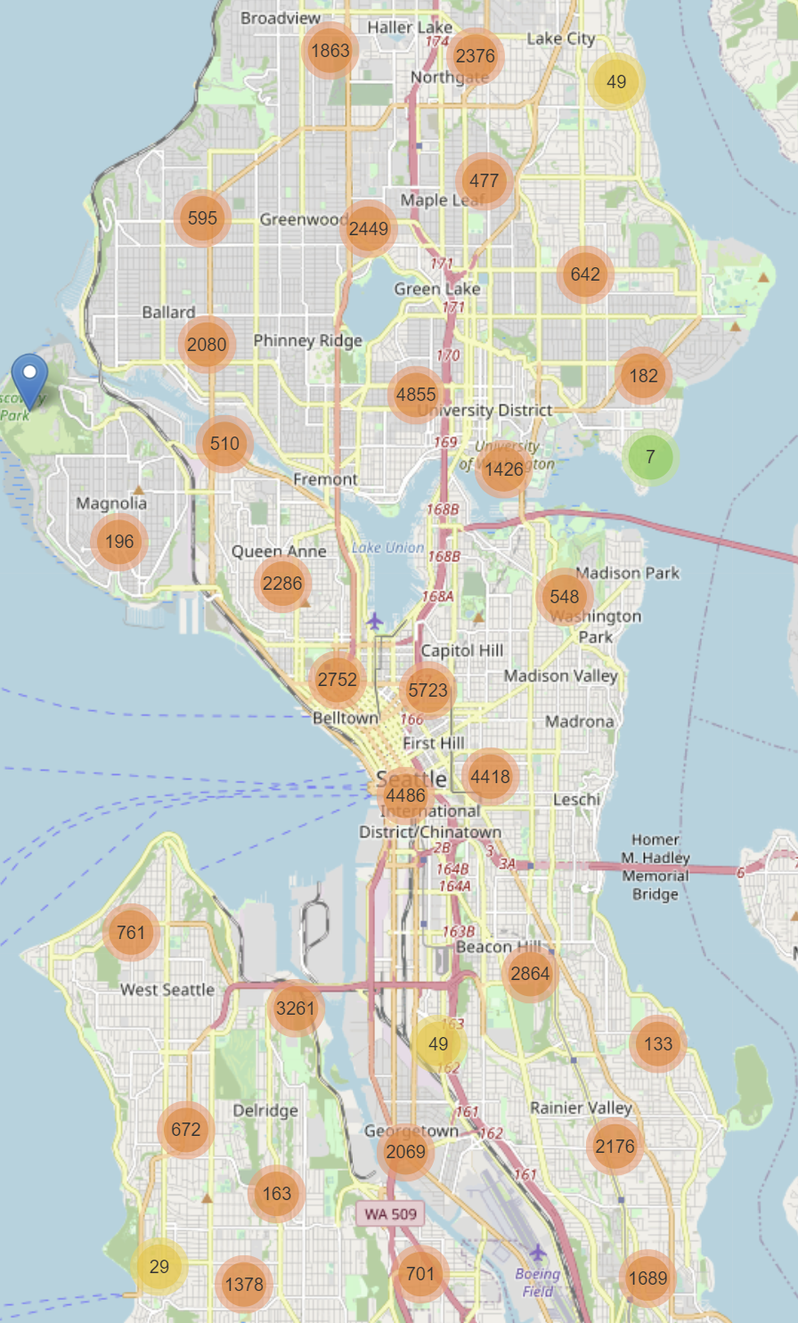
Recommendations
Locations
Alert drivers on the spot!
Majority of accidents are condensed in main roads and downtown ( see map)
STD should be alert drivers:
With push communications
Panels along the road
Make more frequent in days with good weather as people looks tend to be
More distracted.

